Slide 1





Basic in R2
Course Micriobial genome
Presenter: Nguyen Thi My Ai
6/6/2024

Slide 2



R Graphics
●
Histogram
●
Boxplot
●
Barplot
●
Pie charts
●
Plot and Scatterplot

Slide 3
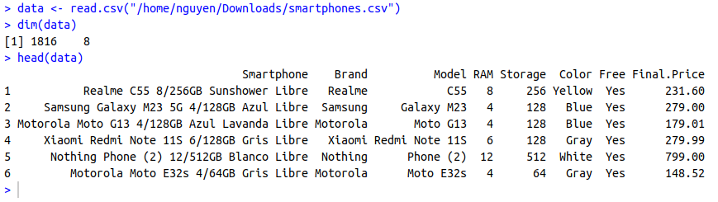
Dataset
Smartphone Name: The unique identifier or model name of the smartphone.
Brand: Smartphone brand.
Model: Smartphone brand model.
RAM (Random Access Memory): The amount of memory available for multitasking.
Storage: capacity of the smartphone.
Color: Color of the smarthpone.
Free: Yes/No if the smartphone is attached to a cell company contract.
Price: The cost of the smartphone in the respective currency.
https://www.kaggle.com/datasets/juanmerinobermejo/smartphones-price-dataset

Slide 4
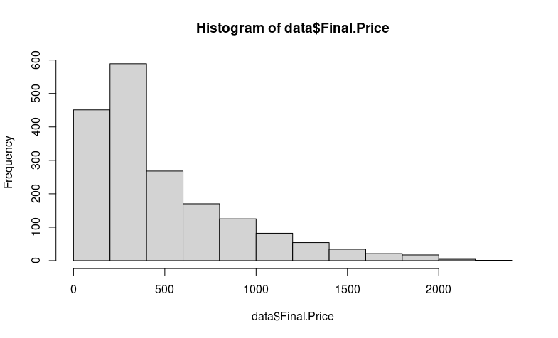
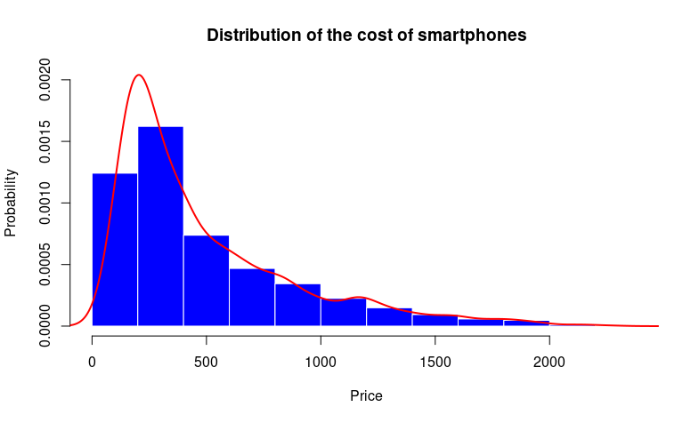
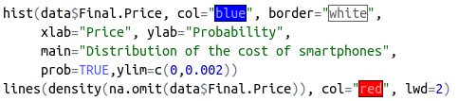
Histogram
hist(var, col, border, xlab, ylab, main, prob, xlim, ylim)
line(density(na.omit(var)), col, lwd)

Slide 5
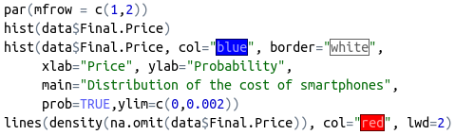
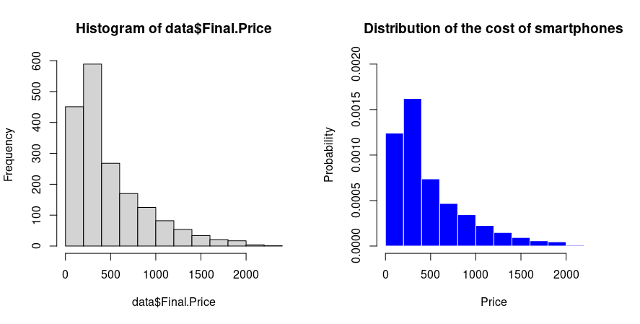
The number of rows
The number of columns

Slide 6
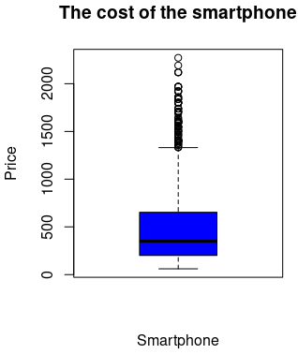
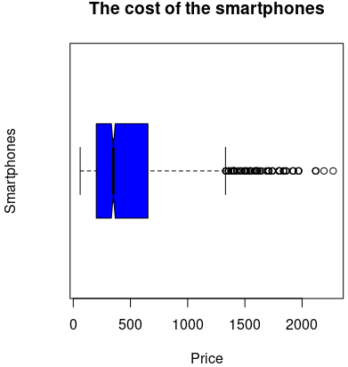


Boxplot
boxplot(var, col, border, xlab, ylab, main, xlim, ylim, notch, horizontal)
boxplot(var1~var2, col, border, xlab, ylab, main, xlim, ylim, notch, horizontal)
Max
Q3
Median
Q1
Min

Slide 7
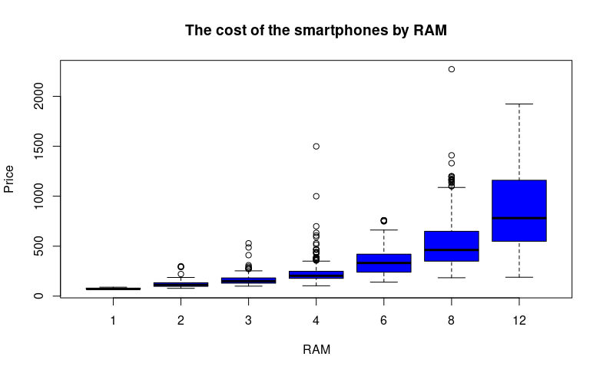
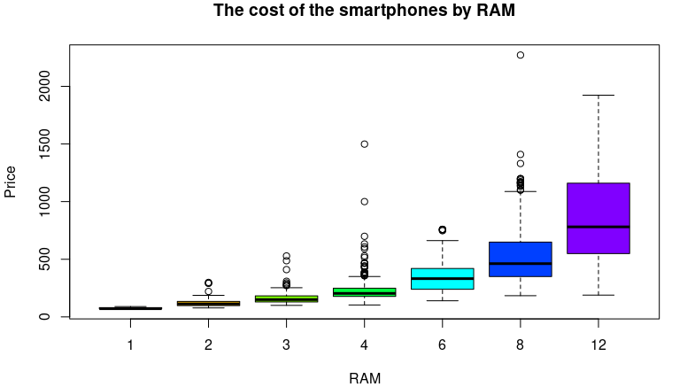

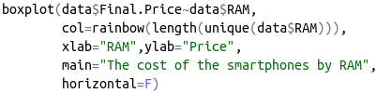

Slide 8
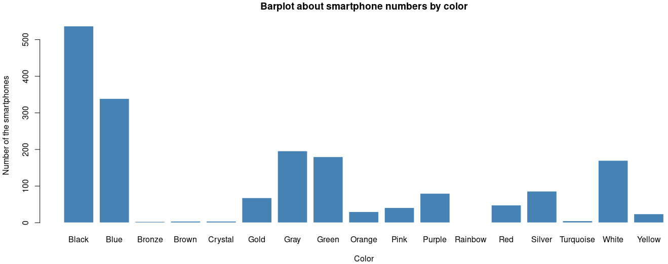
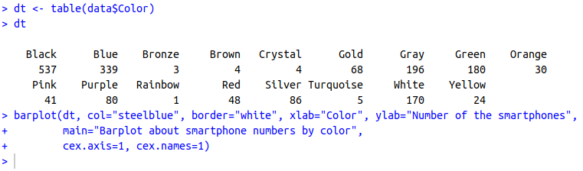
Barplot
barplot(var, col, border, xlab, ylab, main, cex.axis, cex.name, density, las, horiz)

Slide 9
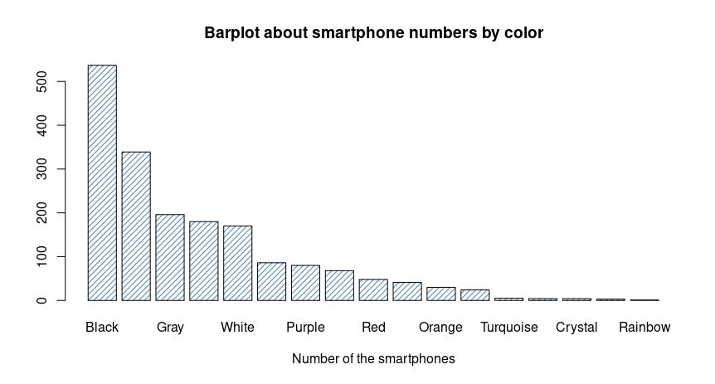


Slide 10
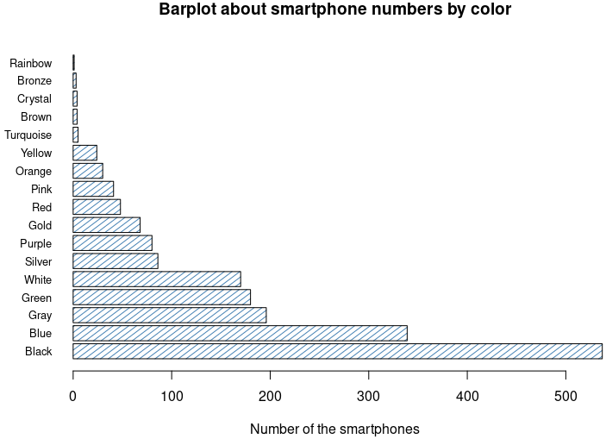


Slide 11
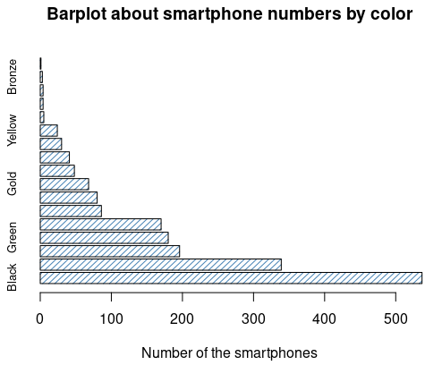
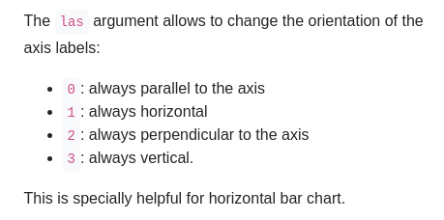
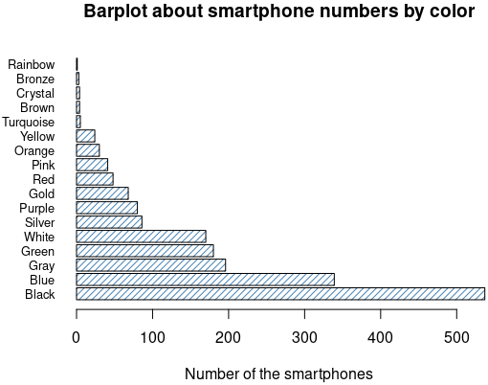


0
1
2
3

Slide 12
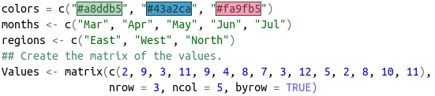
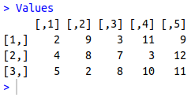
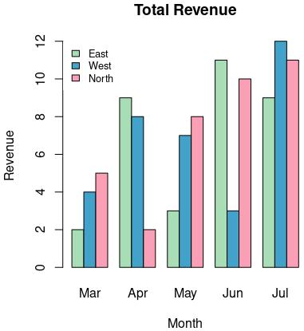
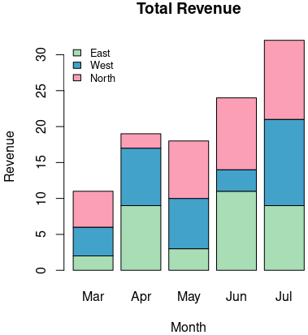



Slide 13
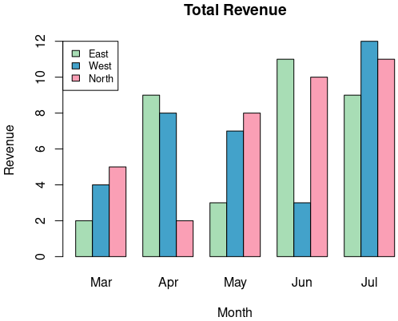
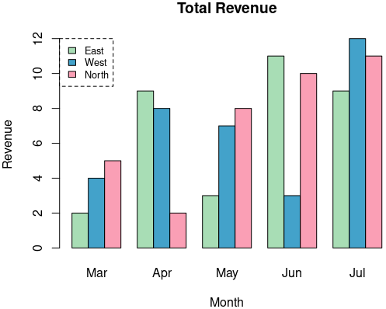
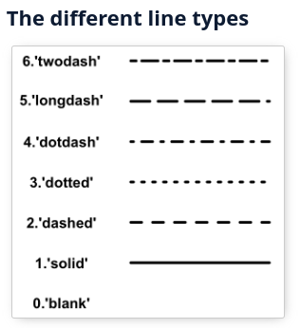


box.lty = (0,1,2,3,4,5,6)
1
2
3
4

Slide 14
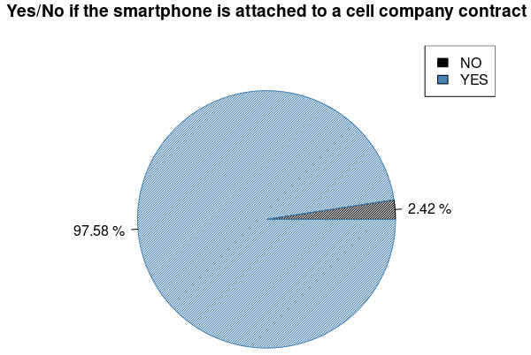
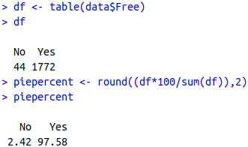

Pie charts
pie(var, label, col, main, density)
legend(position, legend, cex, fill)
“bottomright”, “bottom”,
“bottomleft”, “left”, “topleft”,
“top”, “topright”, “right”,
“center”

Slide 15
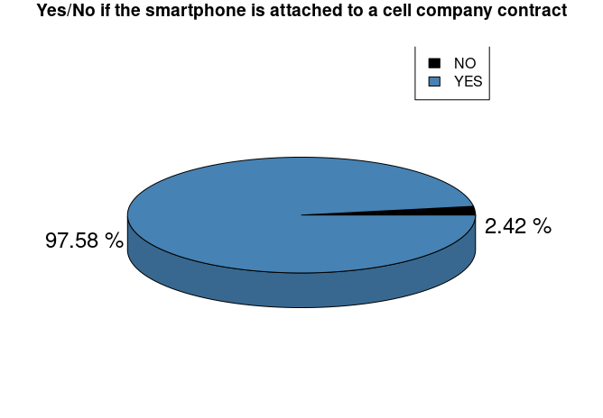
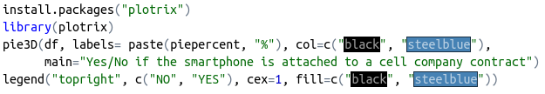

Slide 16
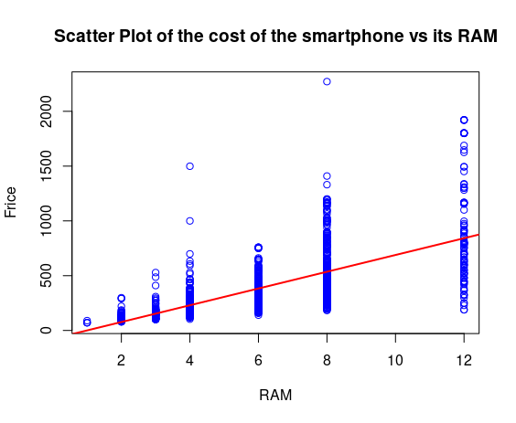
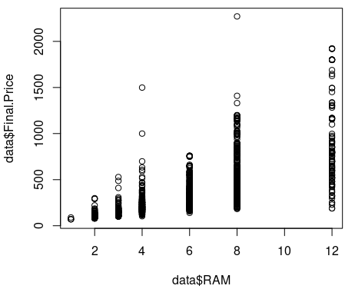
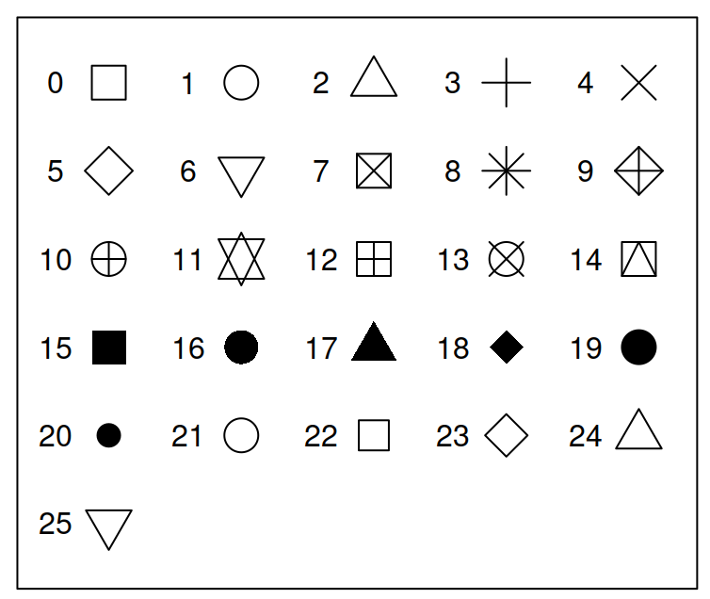

Plot and scatterplot
plot(var1~var2, pch, col, xlab, ylab, main, xlim, ylim)
scatterplot(var1~ var2 | group, pch, col, smooth, grid, frame, xlab, ylab, main)

Slide 17
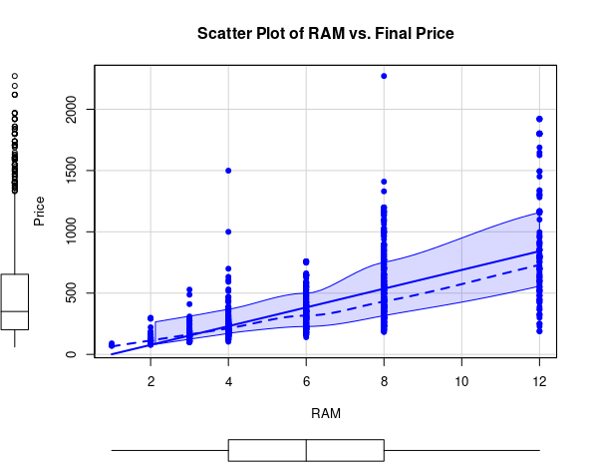
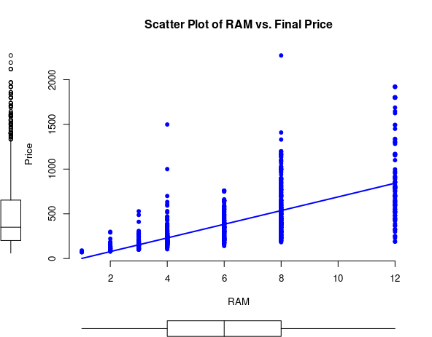
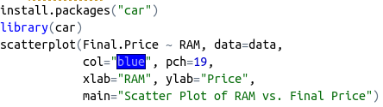


Slide 18
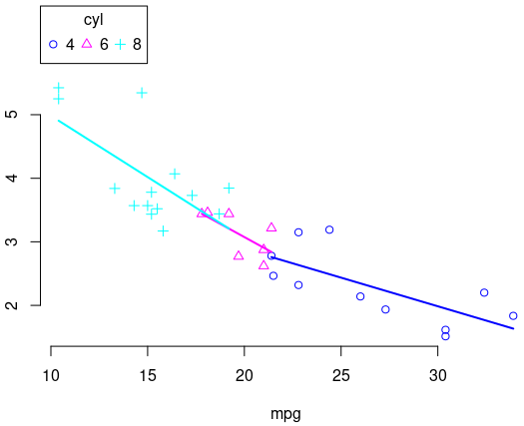
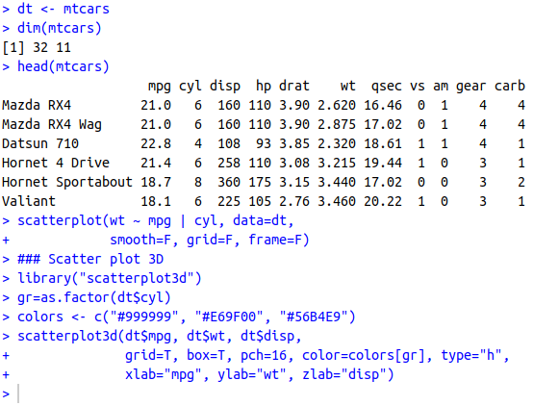
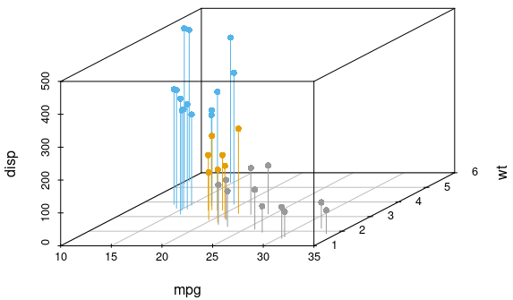
Scatterplot with new dataset

Slide 19
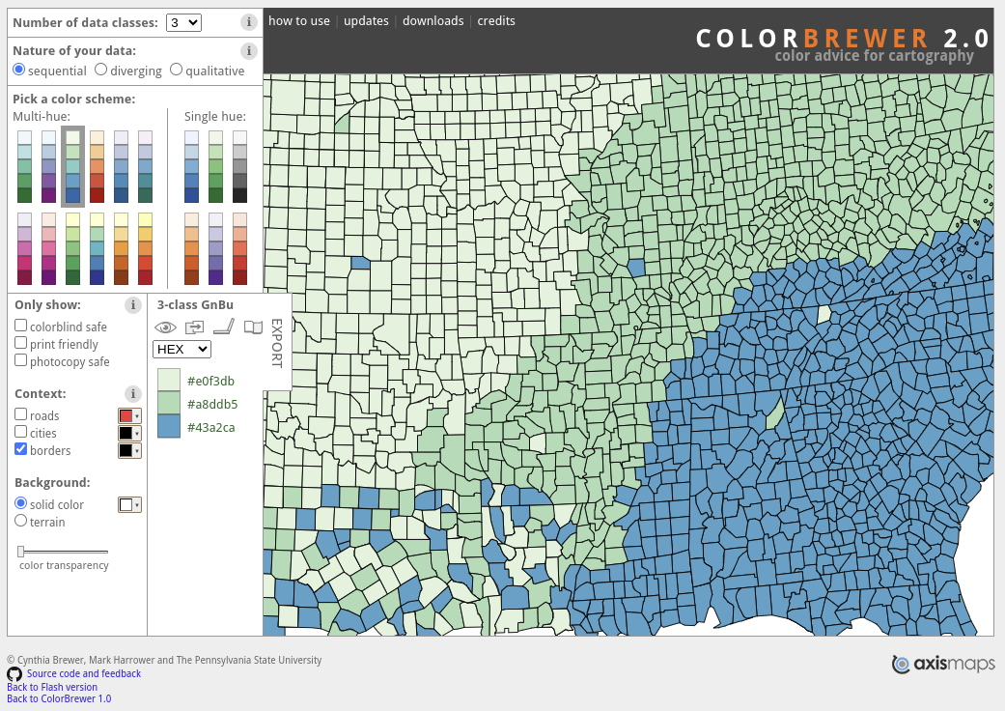
Color palette: ColorBrewer
https://colorbrewer2.org/#type=sequential&scheme=BuGn&n=3

Slide 20

Thank you for your attention!

